Slide 1
Cloud Adoption Framework
Microsoft

Slide 2
The Cloud Adoption Framework is a collection of documentation, implementation guidance, best practices, and tools that are proven guidance from Microsoft designed to accelerate your cloud adoption journey.
Cloud Adoption Lifecycle
Strategy (Why?)
Plan (How?)
Ready (What?)
Adopt (Migrate + Innovate)
Govern
Manage

Slide 3
Things to consider in cloud adoption journey:
Foundational Alignment
Accelerate adoption
Improve controls
Establish teams
FOUNDATIONAL ALIGNMENT
What is Azure?
How Azure Works?
Basic terminologies

Slide 4
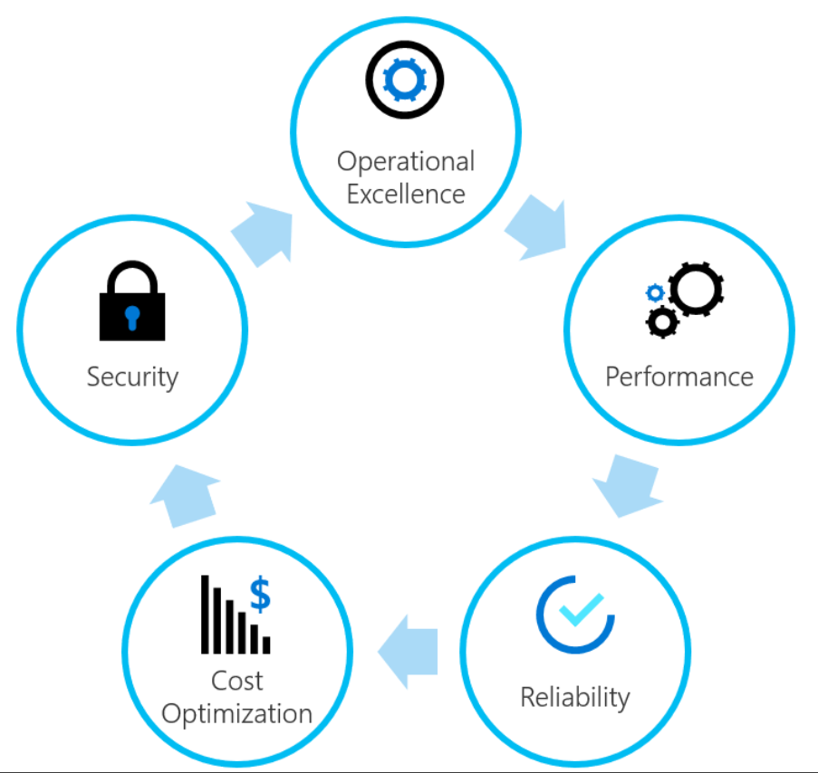
ACCELERATE ADOPTION
Align stakeholders
Gather data and analyze assets and workloads
Create a migration plan
Migrate Workloads
Hand off production workloads
IMPOROVE CONTROLS
Operating Model
The core principles of a well-managed operating model
1. Operational Excellence
2. Performance
3. Reliability
4. Cost optimization
5. Security

Slide 5
1. Operational Excellence
Step 1: Define a strategy
Step 2: Develop an organizational change management plan
Step 3: Manage change across cloud adoption efforts
2. Cost Optimization
How?
Create budget
Monitor resource utilization
Reduce usage of resources
Auditing spending monthly/yearly

Slide 6
3. Security
11 essential security practices:
People:
1. Educate teams about the cloud security journey
2. Educate teams on cloud security
Process:
3. Assign accountability for cloud security decisions
4. Update Incident Response (IR) processes for cloud
5. Establish security posture management
Technology:
6. Require Passwordless or Multi-Factor Authentication (MFA)

Slide 7
7. Integrate native firewall and network security
8. Integrate native threat detection
Foundational Architecture Decisions:
9. Standardize on a single directory and identity
10. Use identity-based access control (instead of keys)
11. Establish a single unified security strategy
Best practices:
Build a shared understanding
Integrate security early into cloud adoption
Use an agile approach
Modernize security strategy
Native capabilities in azure

Slide 8
Lifecycle of CAF
Strategy
Plan
Ready
Adopt
(Migrate+
Innovate)
Govern
Manage

Slide 9
Strategy
Motivations
Business Outcomes
Business Justifications

Slide 10
Plan
Pre-requisites
Define and Prioritize Workloads
Align assets to workloads
Establish iterations and release plans
Estimate timelines

Slide 11
Ready
Azure Setup
Operating Model
Azure Landing Zone

Slide 12
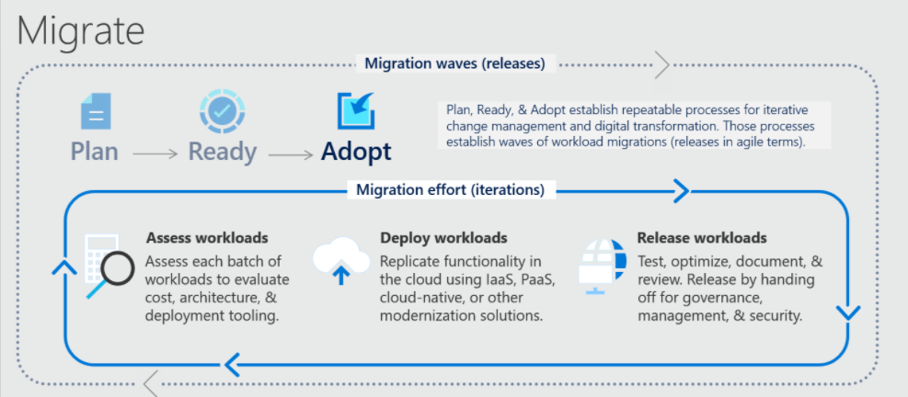
Adopt

Slide 13
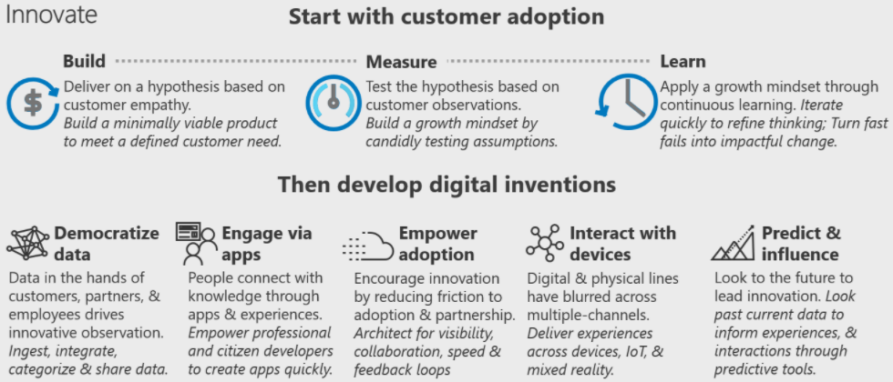

Slide 14
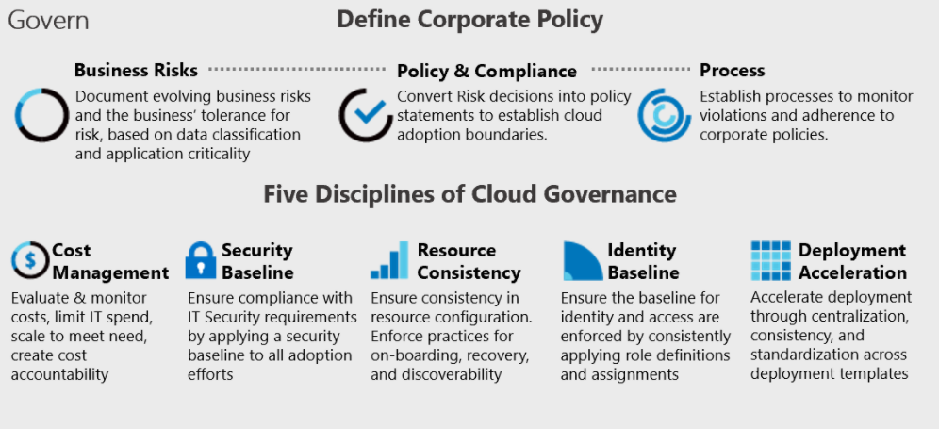
Govern

Slide 15
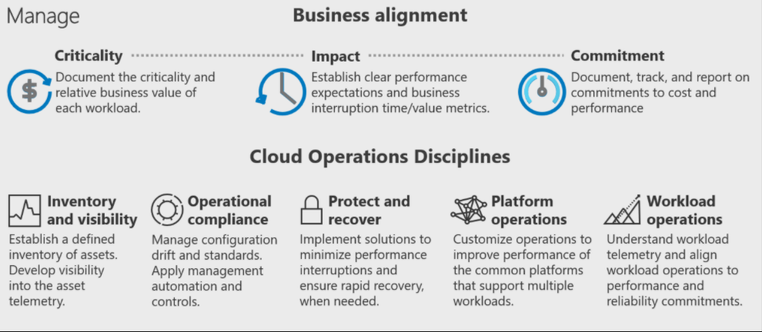
Manage

Slide 16
Thank You

